Slide 1
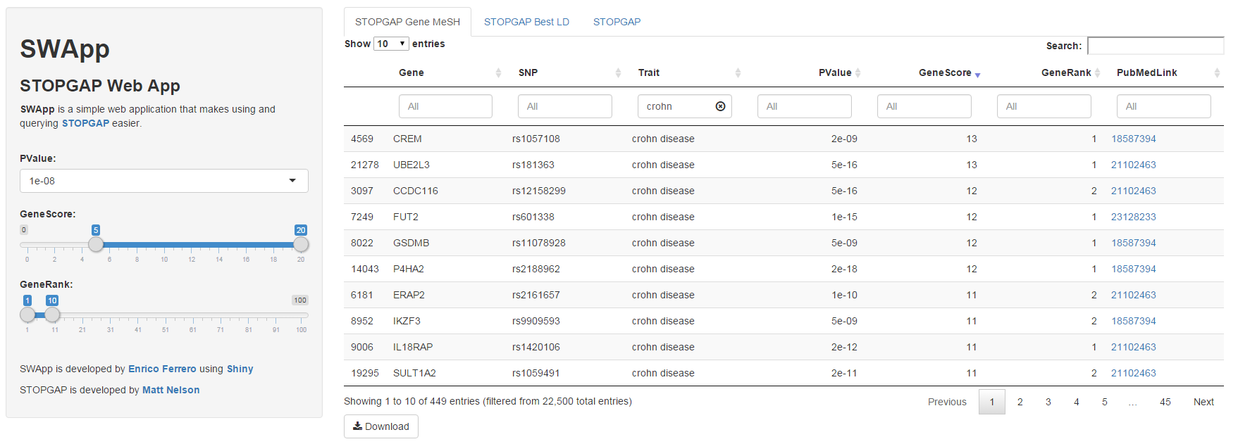
SWApp: STOPGAP Web Application (http://uk1salx00235.corpnet2.com:3839/SWApp/)
CB capability; Target validation
Situation
STOPGAP is an excellent resource to find genetic associations between genes and diseases.
However, it is currently implemented as a set of very large text files and R objects. Querying STOPGAP involves loading the data in Excel or R, which takes a long time. It’s currently very hard for scientists and analysts to quickly check the genetic support for a target or disease of interest.
Action
The three main STOPGAP datasets (STOPGAP Gene Mesh, STOPGAP Best LD and STOPGAP) were first imported into a MySQL database, hosted on the UK Linux servers.
A web application (SWApp) was built on top of the MySQL database using Shiny (a web framework for R) and DT (a library that allows representation of large data tables on websites, using javascript).
SWApp features include:
Browsing of the complete STOPGAP Gene MeSH, STOPGAP Best LD and STOPGAP datasets;
Easy and intuitive on-the-fly querying, filtering and sorting of the data using sidebar controls and column filters;
Clickable links to PubMed records;
Download of filtered results as a CSV file.
Impact
Analysts and scientists can quickly and easily query the STOPGAP data from a web browser, maximising the potential of the STOPGAP resource to identify and validate target – disease relationships.
Notes:
Impact Type: New CB capability
Impact Contribution: Strategic contribution​
Enrico Ferrero
September 2015

